Slide 1

Global Azure Conference 2024

Slide 2



Gold Partner
Venue Partner
Learning Partner

Slide 3


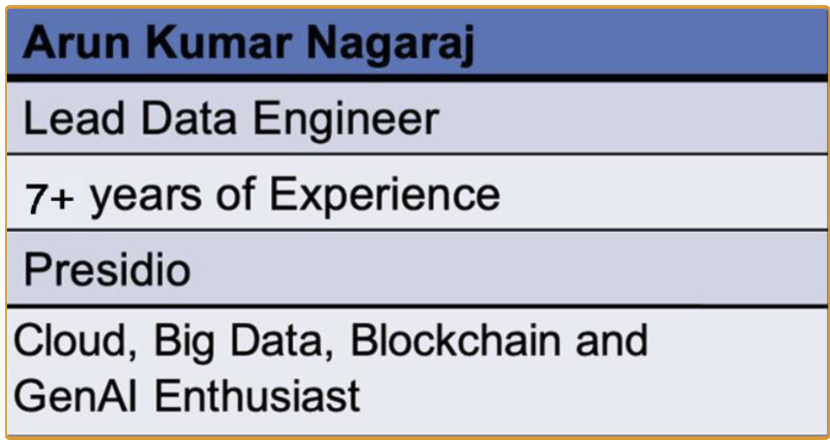
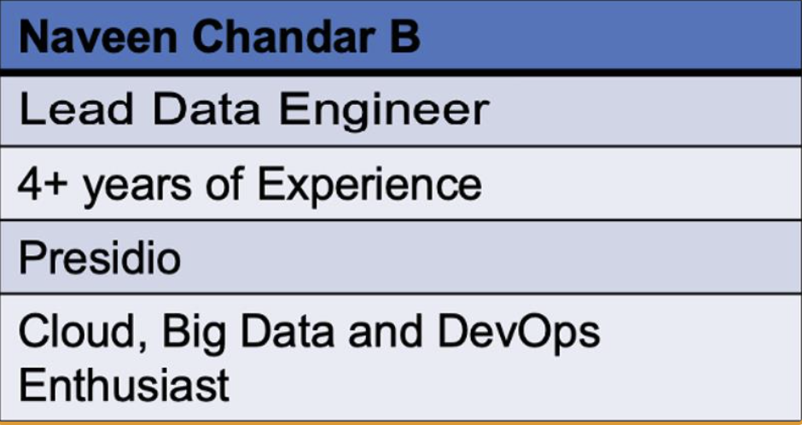
About Us

Slide 4

Integrate LLM with Real-time Data

Slide 5

Agenda
Introduction
Real time data integration with LLM
Function Calling
Demo
Q & A
Notes:
Introduction (10 minutes)
Real-time Data Integration with LLM (5 minutes)
Function Calling(10 minutes)
Demo (10 minutes)
Q&A Session (5 minutes)

Slide 6
Introduction
How many of them used ChatGPT?
What are LLMs?
What are LLMs used for?
Limitations of LLM

Slide 7
Real time data Integration with LLM
Timely Insights
Enhanced decision making
Improved customer Experience
Better Risk Management

Slide 8
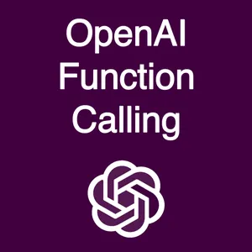
Introduction to Function Calling
Connects with External tools
Supported Models: GPT-3.5-turbo-0125 and GPT-4-turbo-preview
Notes:
Function Calling API connects large language models to external tools. While invoking an API call, can describe functions, and the model intelligently chooses to output a JSON object containing arguments to call the appropriate function.

Slide 9
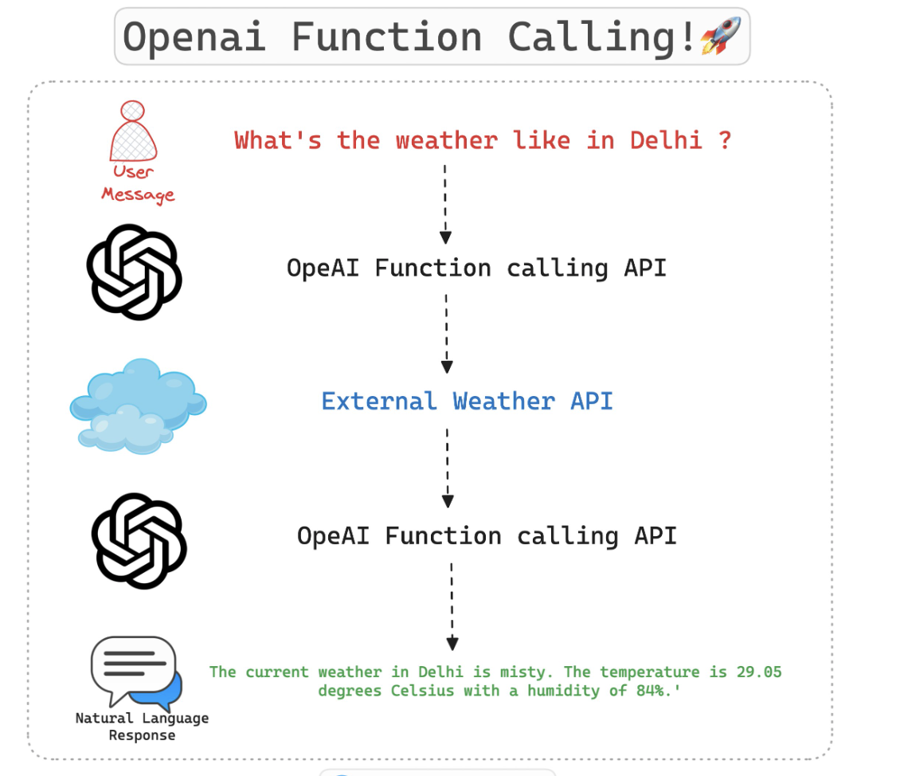
Example: Function Calling

Slide 10
Steps for Implementing function call
Define Function description
Define the actual function
Call the function using LLM.

Slide 11
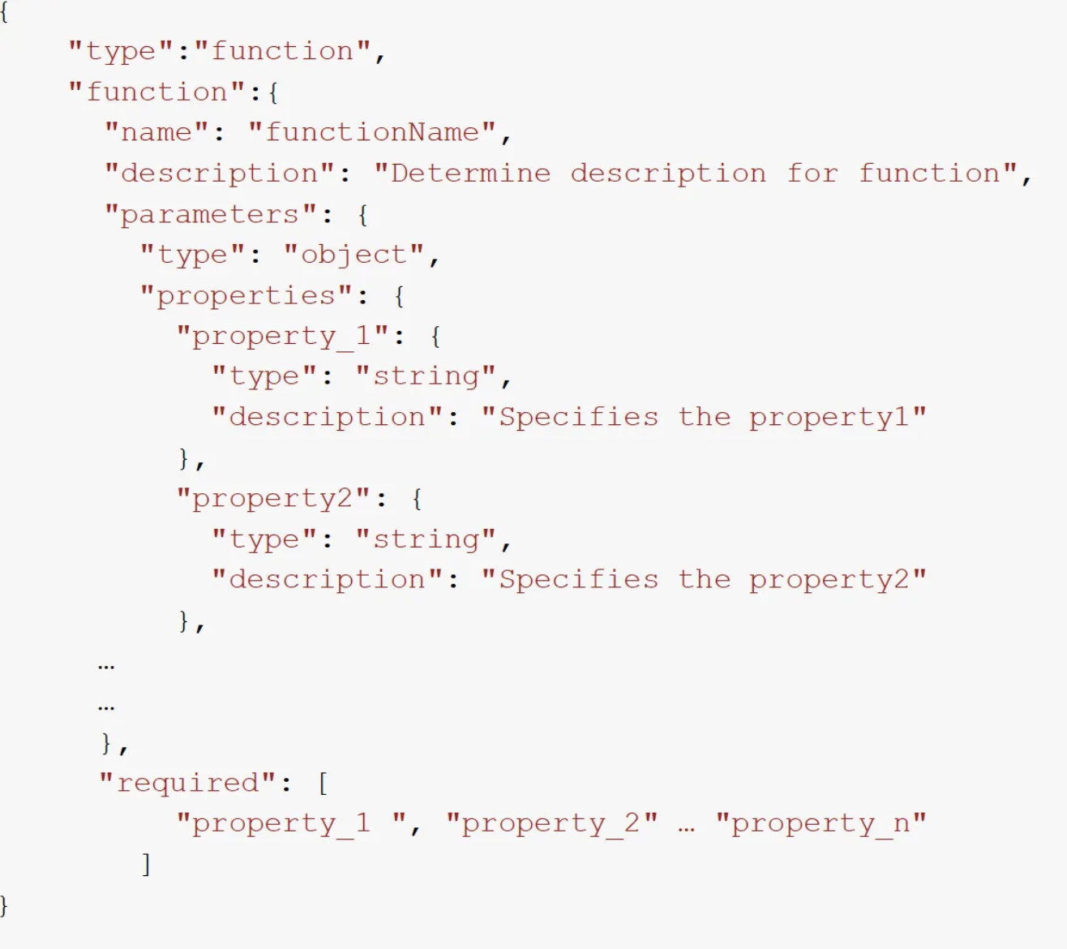
Step1: Define function Description

Slide 12
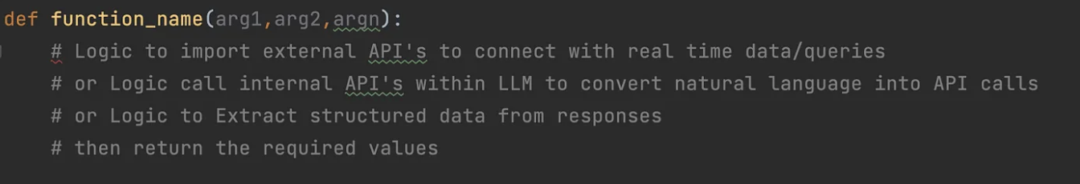
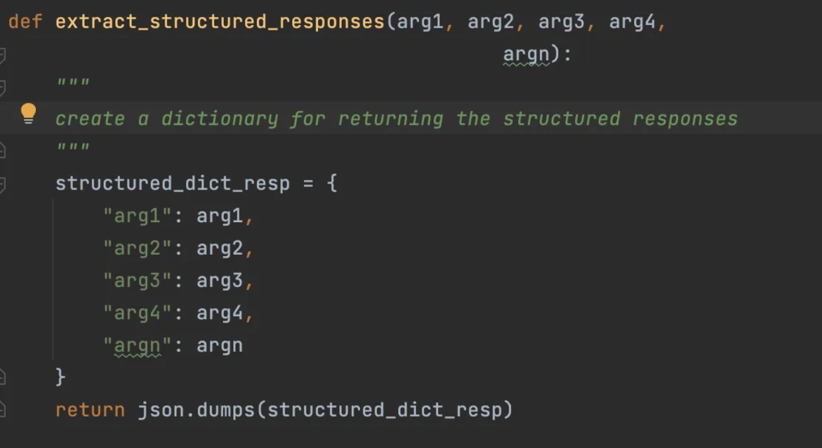
Step2: Define function

Slide 13
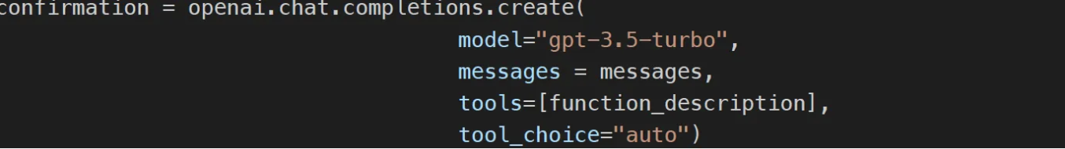
Step 3: Call function using LLM

Slide 14
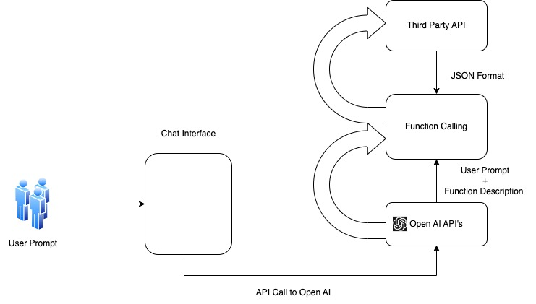
Function Calling

Slide 15
Demo

Slide 16
Q & A

Slide 17
Feedback

Slide 18
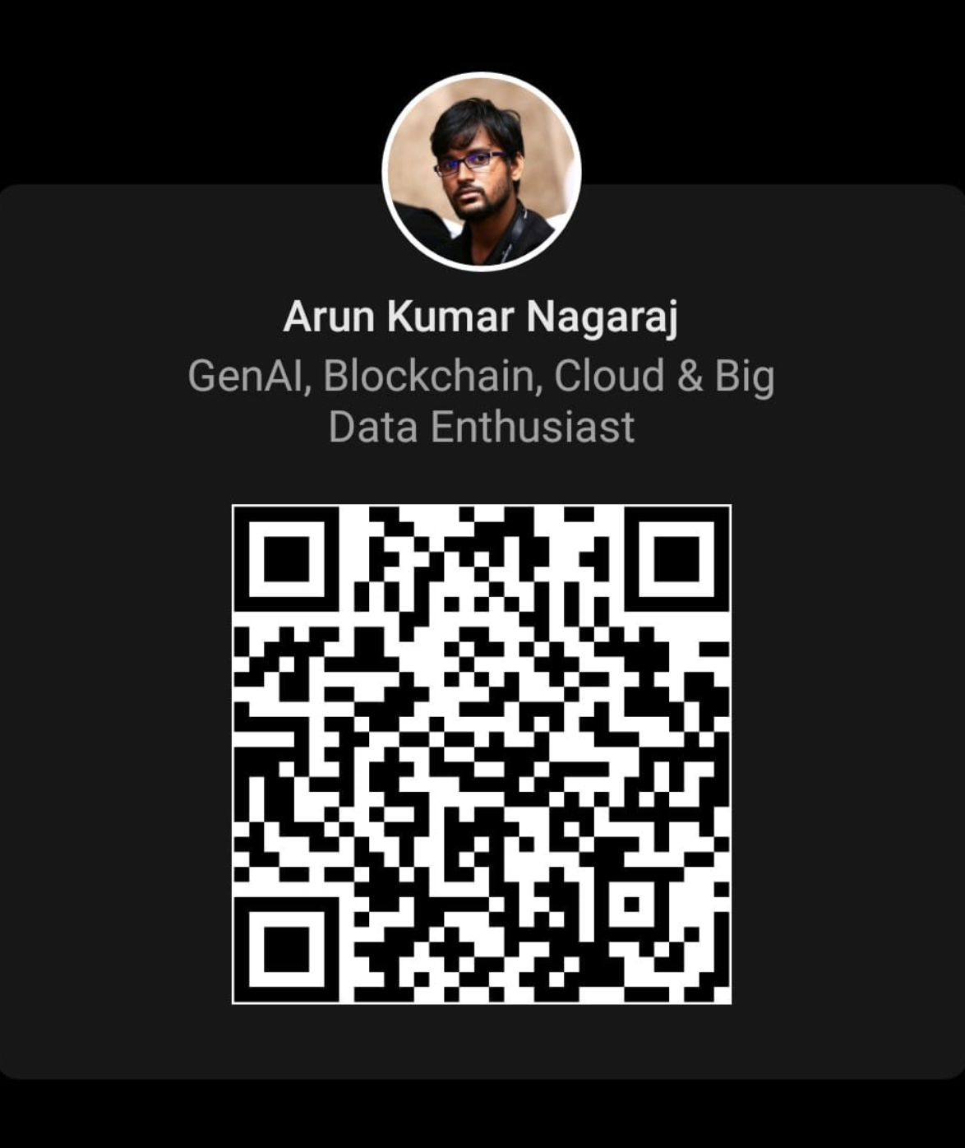
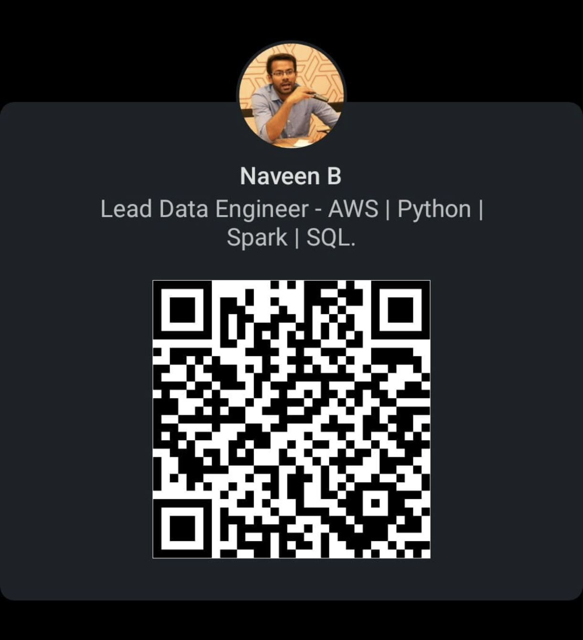
Arun Kumar Nagaraj
`
Naveen B
https://www.linkedin.com/in/naveenchandarb/

